Slide 1
SMA
West Bengal
Social Media Analytics Update
Start Date | 29 Sep, 2024 | End Date | 05 Oct, 2024 | Duration | 7 Days | Analysed Properties | 105
Analysis Date:11th Oct'24

Slide 2
Table of Contents
Section | Sub-Section | Analysis | Slide No.
Section 1: Overall State Party Summary | Section 1.1: Overall Party Official Pages Summary | Party Official Pages Overview | 7
 |  | Facebook Party Official Pages (7 DMA) | 8
 |  | Twitter Party Official Pages (7 DMA) | 9
 |  | Instagram Party Official Pages (7 DMA) | 10
 |  | YouTube Party Official Pages (7 DMA) | 11
 | Section 1.2: Party Official Pages Comparative Analysis | Facebook Party Official Pages Weekly Performance | 14-15
 |  | Twitter Party Official Pages Weekly Performance | 17-18
 |  | Instagram Party Official Pages Weekly Performance | 20-21
 |  | YouTube Party Official Pages Weekly Performance | 23-24
 | Section 1.3: Party Official Pages Most Engaging Post | Facebook Party Official Pages Most Engaging Post | 26
 |  | Twitter Party Official Pages Most Engaging Post | 27
 |  | Instagram Party Official Pages Most Engaging Post | 28
 |  | YouTube Party Official Pages Most Engaging Post | 29
Section 2: Overall State Leaders Summary | Section 2.1: Overall Top Leaders Pages Summary | Top Leaders Official Pages Overview - Overall | 32
 |  | Top Leaders Official Pages Overview – Last 7 Days | 33
 |  | Facebook Top Leader Official Pages (7 DMA) | 34
 |  | Twitter Top Leader Official Pages (7 DMA) | 35
 |  | Instagram Facebook Top Leader Official Pages (7 DMA) | 36
 |  | YouTube Facebook Top Leader Official Pages (7 DMA) | 37

Slide 3
Table of Contents
Section | Sub-Section | Analysis | Slide No.
Section 2: Overall State Leaders Summary | Section 2.2: Top Leaders Pages Most Engaging Post | Facebook Top Leaders Most Engaging Post | 39
 |  | Twitter Top Leaders Most Engaging Post | 40
 |  | Instagram Top Leaders Most Engaging Post | 41
 |  | YouTube Top Leaders Most Engaging Post | 42
 | Section 2.3: All Leaders Weekly Comparative Analysis | Facebook Followers and Activity Weekly Performance | 45
 |  | Facebook Activity and Views Weekly Performance | 46
 |  | Facebook Engagement Weekly Performance | 47
 |  | Twitter Followers and Activity Weekly Performance | 49
 |  | Twitter Activity and Views Weekly Performance | 50
 |  | Twitter Engagement Weekly Performance | 51
 |  | Twitter Impression Weekly Performance | 52
 |  | Instagram Followers and Activity Weekly Performance | 54
 |  | Instagram Activity and Views Weekly Performance | 55
 |  | Instagram Engagement Weekly Performance | 56
 |  | YouTube Followers and Activity Weekly Performance | 58
 |  | YouTube Activity and Views Weekly Performance | 59
 |  | YouTube Engagement Weekly Performance | 60

Slide 4
Table of Contents
Section | Sub-Section | Analysis | Slide No.
Section 3: Campaign Pages Weekly Comparative Analysis |  | Facebook Followers and Activity Weekly Performance | 63
 |  | Facebook Activity and Views Weekly Performance | 64
 |  | Facebook Engagement Weekly Performance | 65
 |  | Twitter Followers and Activity Weekly Performance | 67
 |  | Twitter Activity and Views Weekly Performance | 68
 |  | Twitter Engagement Weekly Performance | 69
 |  | Twitter Impression Weekly Performance | 70
 |  | Instagram Followers and Activity Weekly Performance | 72
 |  | Instagram Activity and Views Weekly Performance | 73
 |  | Instagram Engagement Weekly Performance | 74
 |  | YouTube Followers and Activity Weekly Performance | 76
 |  | YouTube Activity and Views Weekly Performance | 77
 |  | YouTube Engagement Weekly Performance | 78
Section 4: Annexure |  | Party Details | 80
 |  | Leader Details | 81
 |  | Campaign Details | 82

Slide 5
Parties
Although BJP has 1.5 times the followers of AITC, AITC surpasses them in average engagement, indicating that its audience is more interactive on Facebook. (pg.12)
AITC excels in audience engagement on Twitter, achieving approximately 6 times the average engagement and 2 times the engagement rate of the second-highest party. (pg.13)
CPI(M) boasts an engagement rate 4 times that of the second-highest party, AITC, demonstrating a more active and engaging audience on Instagram. (pg.14)
CPI(M) leads YouTube in both engagement metrics and overall activity. (pg.12)
Despite a 16% increase in activity on Facebook, INC saw a significant decline in engagement metrics, with a 48% drop in average engagement and a 39% drop in engagement rate compared to last week. (pg.17)
AITC's 31% decrease in activity resulted in the largest drop in engagement compared to the previous week in Twitter. (pg.20)
Even with a 42% reduction in activity, AITC's average engagement per post rose by 11% compared to last week in Instagram. (pg.23)
Despite an 18% increase in activity, BJP's engagement on YouTube fell by 31% compared to the previous week. (pg.26)

Slide 6
Leaders
AITC Leader Mamata Banerjee experienced a remarkable increase in activity (approximately 5 times) and engagement rate (around 6 times) on Facebook since October 1st. (pg.38)
Despite BJP Leader Dilip Ghosh having the highest activity on Twitter, his engagement and engagement rate are minimal compared to other leaders. (pg.39)
BJP Leader Suvendu Adhikari experienced a steady increase in engagement rate (130%) throughout the week on Twitter. (pg.39)
AITC Leader Mamata Banerjee faced a gradual decline in average engagement (63%) over the week on Instagram. (pg.40)
Although BJP Leader Suvendu Adhikari saw a drop in average engagement and engagement rate on October 2nd, he still outperformed all other leaders on YouTube. (pg.41)
AITC Leader Dr. Santanu Sen achieved an average of 177.4k video views on Facebook, representing a staggering 2193% increase compared to last week. (pg.49)
BJP Leader Agnimitra Paul garnered an average of 36.4k video views on Twitter, marking an impressive 5158% increase compared to last week. (pg.53)
Even Though AITC Leader Nussrat Jahan has the highest growth in follower base in the past week, she still underperforms in terms of engagement compared to previous week in Instagram.(pg.59)

Slide 7
Campaign
Although Banglar Gorbo Mamata reduced their activity by 11%, they experienced significant increases in average video views (46%), engagement (35%), and average engagement (51%) on YouTube compared to last week, indicating enhanced content quality and a highly engaged follower base. (pg.79)

Slide 8
SMA
Section 1:
State Level-Party Pages Analysis

Slide 9
SMA
Section 1.1:
Party Official Pages-Summary

Slide 10
Party Official Pages Overview
Overall
Party | Facebook |  |  |  | Instagram |  |  |  | Twitter |  |  |  | YouTube
 | Total Follower | Average Post Per Day | Average Engagement | Engagement Rate | Total Follower | Average Post Per Day | Average Engagement | Engagement Rate | Total Follower | Average Post Per Day | Average Engagement | Engagement Rate | Total Follower | Average Video Views | Average Engagement | Engagement Rate
AITC | 1.6M | 13.6 | 2,041.0 | 1.8 | 130.8k | 9.4 | 601.2 | 4.3 | 702.2k | 12.6 | 661.1 | 1.2 | 639.0k | 85,848.5 | 141.7 | 0.1
BJP | 2.5M | 16.1 | 736.1 | 0.5 | 239.4k | 2.8 | 1,581.8 | 1.8 | 464.1k | 15.9 | 187.4 | 0.6 | 302.0k | 10,202.2 | 333.4 | 0.4
INC | 125.1k | 5.5 | 206.5 | 0.9 | 3.7k | - | - | - | 58.9k | 4.9 | 25.4 | 0.2 | - | - | - | -
CPI(M) | 466.0k | 6.1 | 982.8 | 1.3 | 83.1k | 11.7 | 1,451.7 | 20.5 | 165.3k | 2.6 | 177.2 | 0.3 | 300.0k | 6,366.7 | 374.5 | 1.3
Last 7 Days
Party | Facebook |  |  |  | Instagram |  |  |  | Twitter |  |  |  | YouTube
 | Total Follower | Average Post Per Day | Average Engagement | Engagement Rate | Total Follower | Average Post Per Day | Average Engagement | Engagement Rate | Total Follower | Average Post Per Day | Average Engagement | Engagement Rate | Total Follower | Average Video Views | Average Engagement | Engagement Rate
AITC | 1.6M | 9.0 | 1,043.0 | 0.6 | 130.8k | 7.0 | 461.2 | 2.5 | 702.2k | 9.0 | 533.0 | 0.7 | 639.0k | 1,347.0 | 105.6 | 0.1
BJP | 2.5M | 14.1 | 522.4 | 0.3 | 239.4k | 1.9 | 1,078.5 | 0.8 | 464.1k | 14.7 | 109.0 | 0.3 | 302.0k | 2,910.3 | 129.8 | 0.1
INC | 125.1k | 6.1 | 153.3 | 0.8 | 3.7k | - | - | - | 58.9k | 8.4 | 21.0 | 0.3 | - | - | - | -
CPI(M) | 466.0k | 5.6 | 752.7 | 0.9 | 83.1k | 7.1 | 869.3 | 7.5 | 165.3k | 1.7 | 106.2 | 0.1 | 300.0k | 5,771.9 | 323.3 | 0.8
*Duration: 29 Sep, 2024 – 05 Oct, 2024

Slide 11
SMA
Section 1.2:
Party Official Pages-Comparative Weekly Performance

Slide 12

Party Official Pages (7 DMA)
AVERAGE POST PER DAY
FOLLOWER
AVERAGE ENGAGEMENT
ENGAGEMENT RATE
*Duration: 29 Sep, 2024 – 05 Oct, 2024
— AITC — BJP — INC — CPI(M)

Slide 13

Party Official Pages (7 DMA)
AVERAGE POST PER DAY
FOLLOWER
AVERAGE ENGAGEMENT
ENGAGEMENT RATE
*Duration: 29 Sep, 2024 – 05 Oct, 2024
— AITC — BJP — INC — CPI(M)

Slide 14

Party Official Pages (7 DMA)
AVERAGE POST PER DAY
FOLLOWER
AVERAGE ENGAGEMENT
ENGAGEMENT RATE
*Duration: 29 Sep, 2024 – 05 Oct, 2024
— AITC — BJP — INC — CPI(M)

Slide 15

Party Official Pages (7 DMA)
AVERAGE POST PER DAY
FOLLOWER
AVERAGE ENGAGEMENT
ENGAGEMENT RATE
*Duration: 29 Sep, 2024 – 05 Oct, 2024
— AITC — BJP — INC — CPI(M)

Slide 16
SMA
Facebook (All Parties)

Slide 17
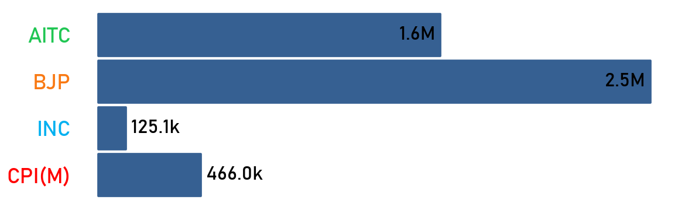
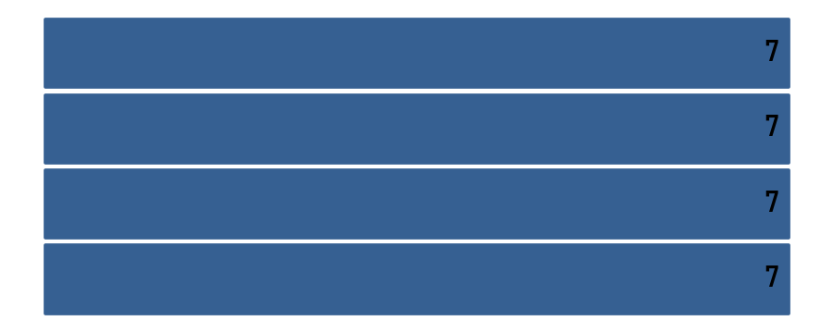
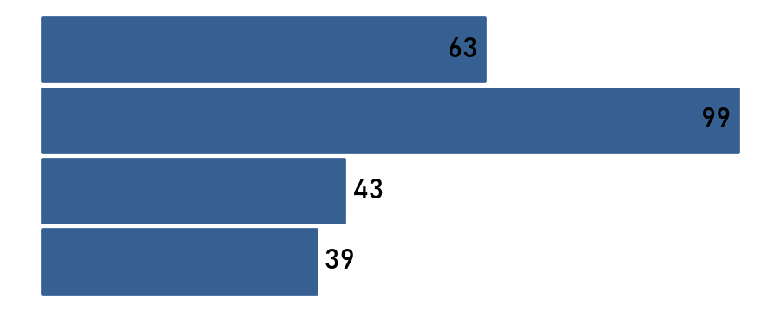
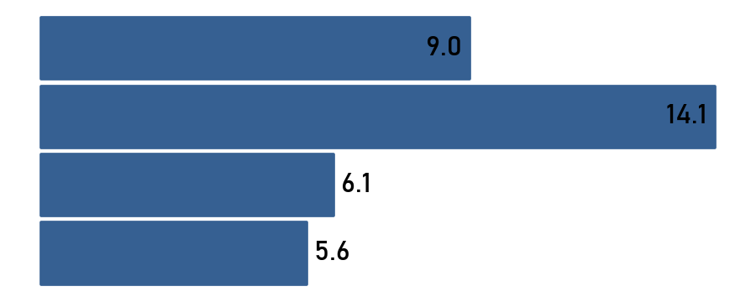
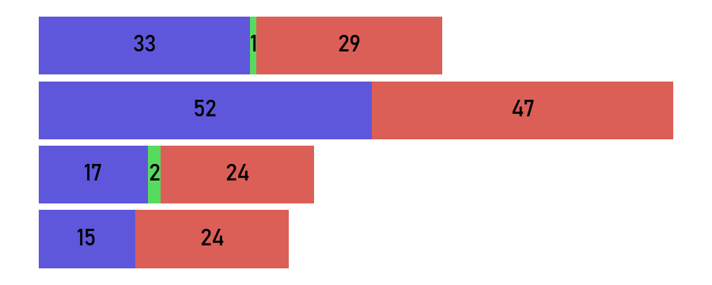
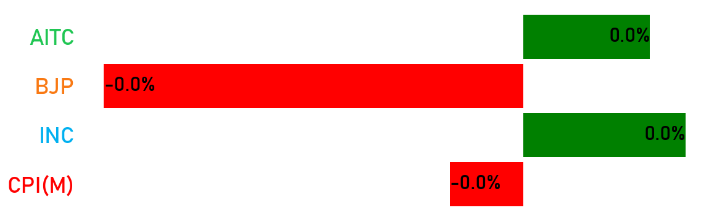
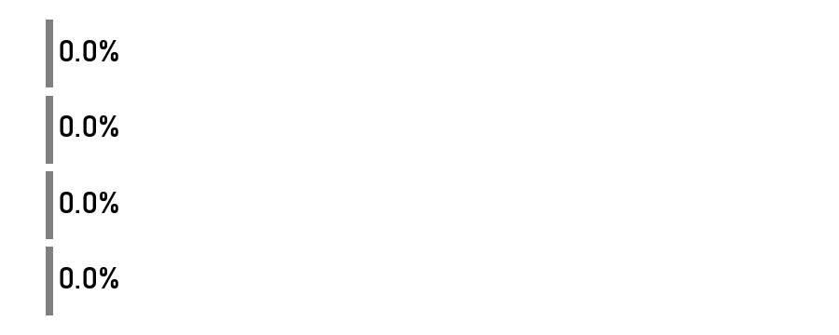
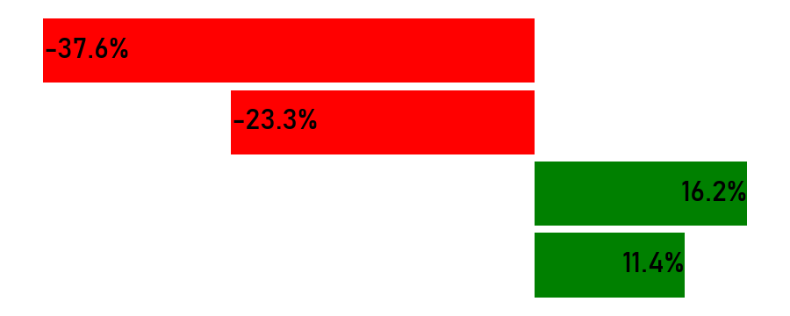
Party Official Pages Weekly Performance
Total Follower
Count of Active Days
Total Post
Avg. Post Per Days
Type of Post
Last 7 Days
Changes
*Duration: 29 Sep, 2024 – 05 Oct, 2024
Link Photo Status Video
- No activity in previous week
- No activity in current week

Slide 18
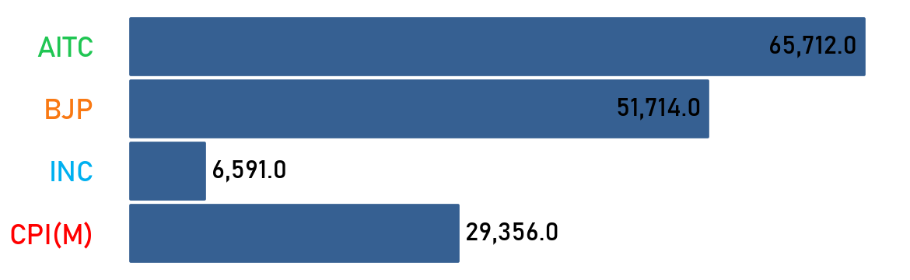
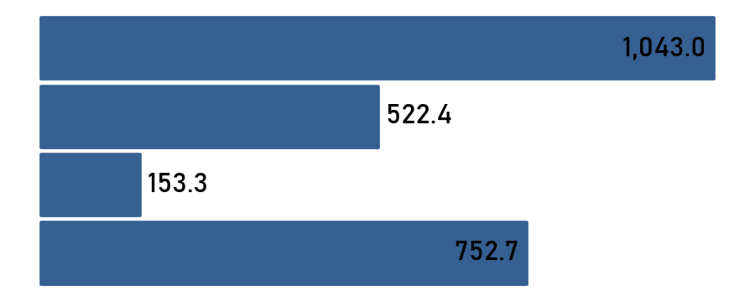
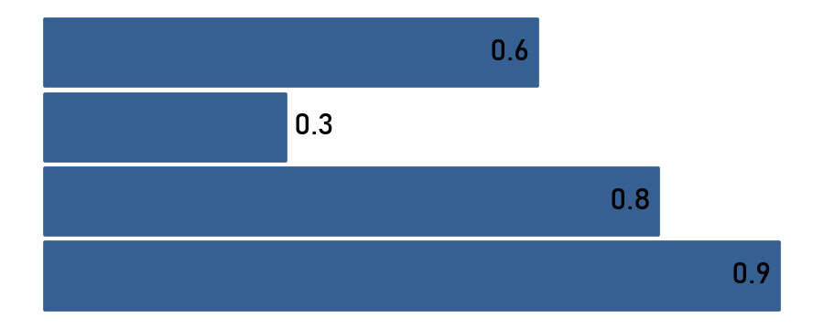
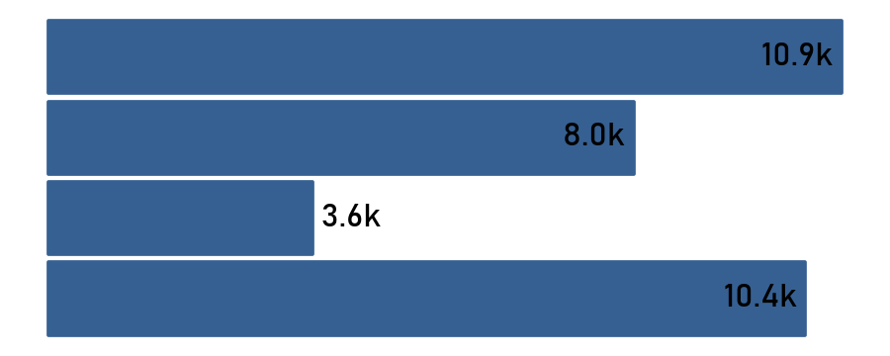
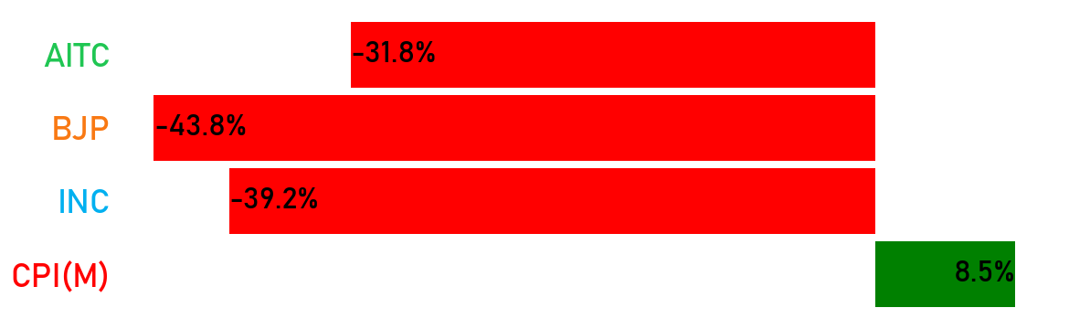
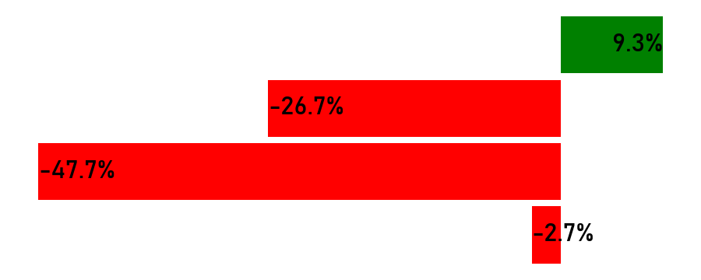
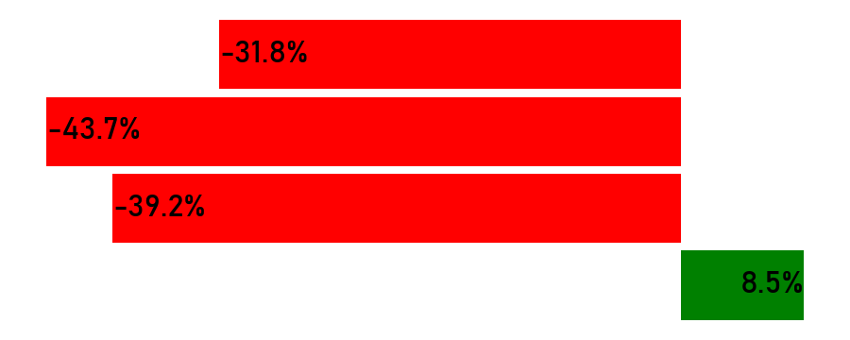
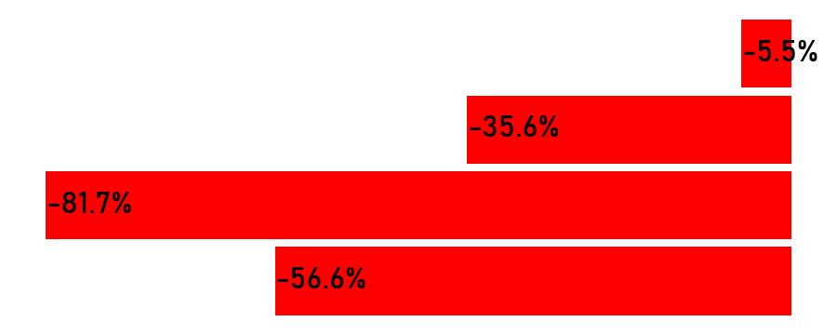
Party Official Pages Weekly Performance
Total Engagement
Avg. Engagement
Engagement Rate
Avg. Video Views
Last 7 Days
Changes
*Duration: 29 Sep, 2024 – 05 Oct, 2024
- No activity in previous week
- No activity in current week

Slide 19
SMA
Twitter (All Parties)

Slide 20
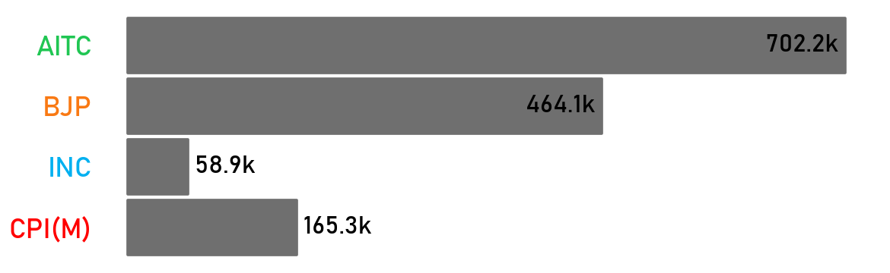
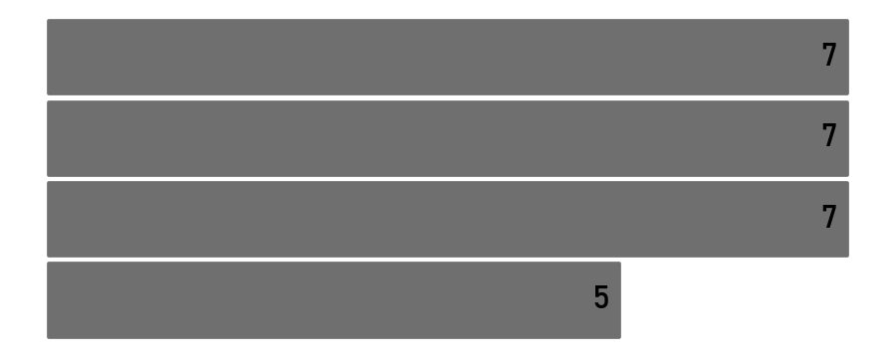
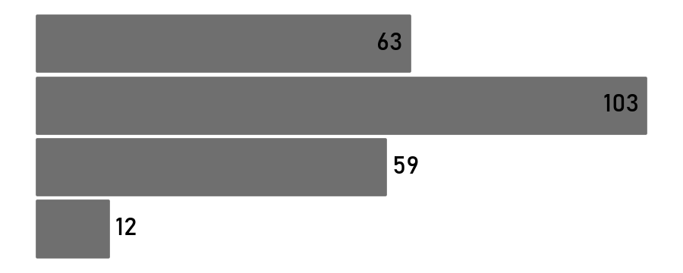

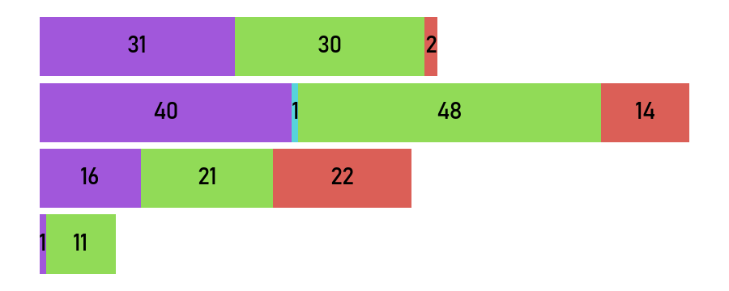
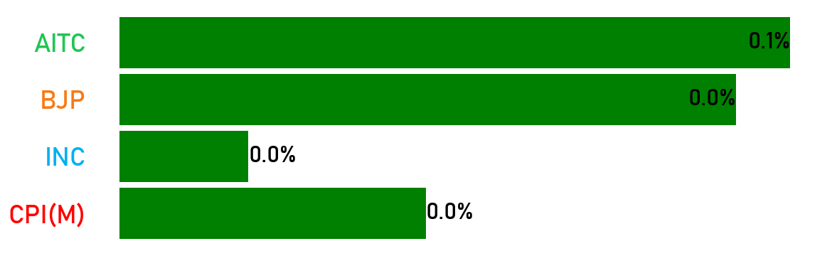
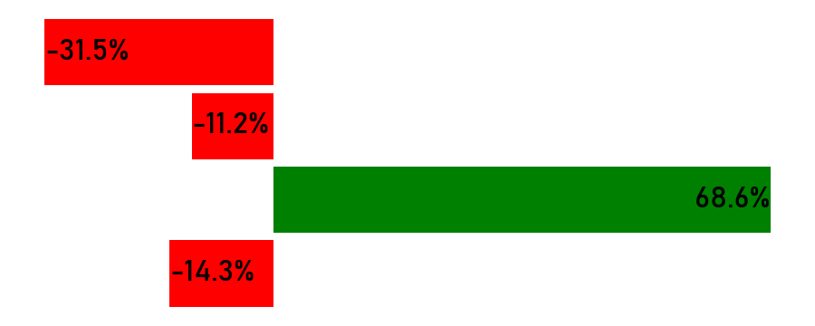
Party Official Pages Weekly Performance
Total Follower
Count of Active Days
Total Post
Avg. Post Per Days
Type of Post
Last 7 Days
Changes
*Duration: 29 Sep, 2024 – 05 Oct, 2024
Link Photo Status Video
- No activity in previous week
- No activity in current week

Slide 21
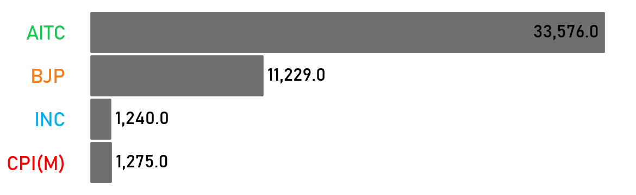
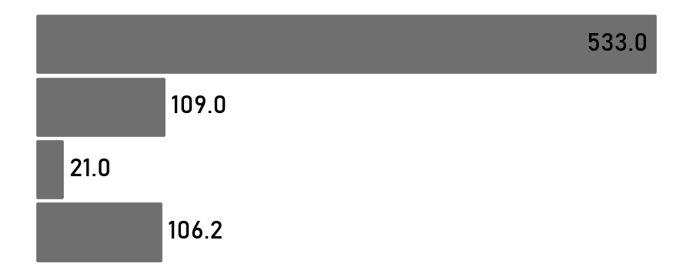
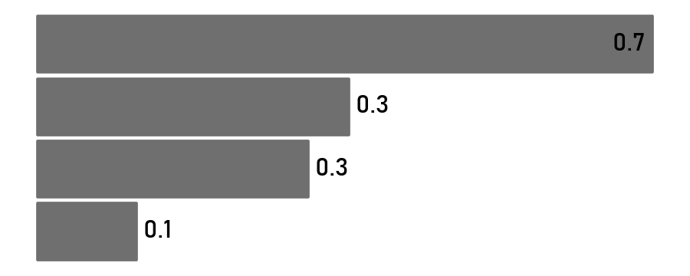
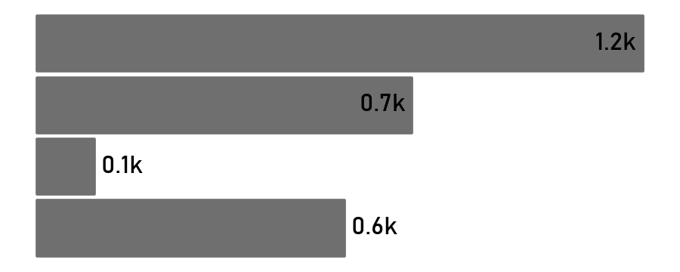
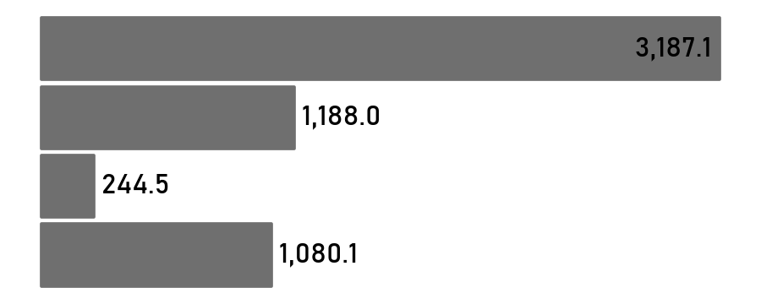
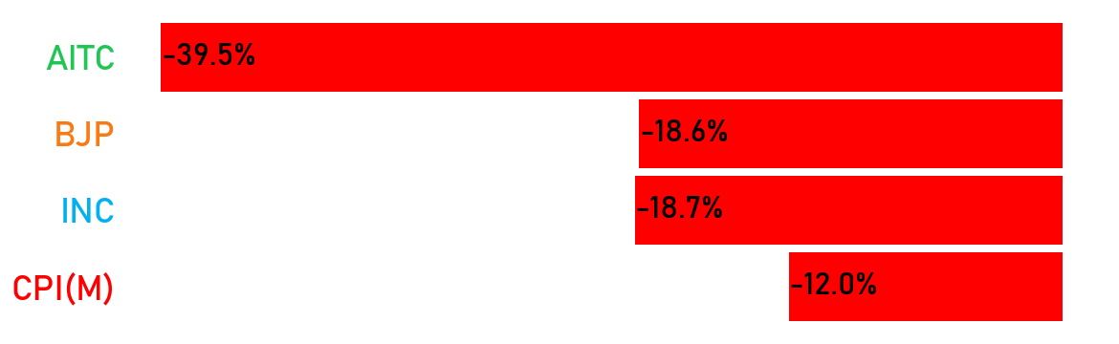
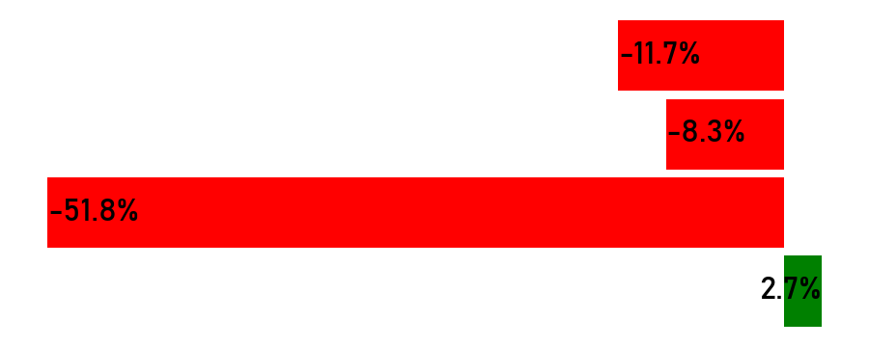
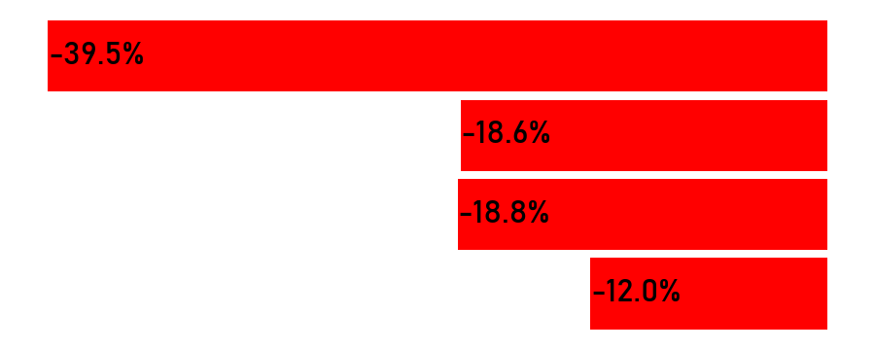
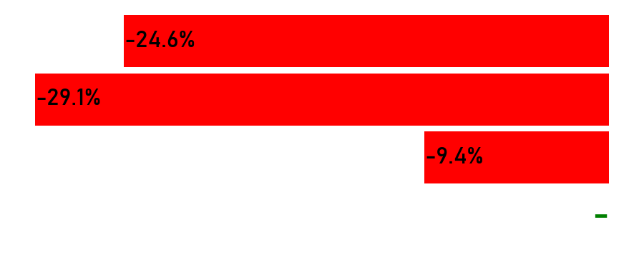
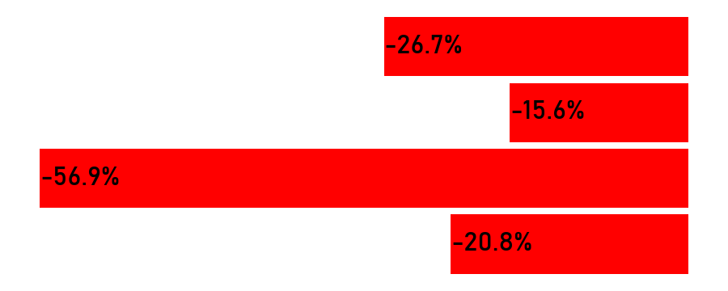
Party Official Pages Weekly Performance
Total Engagement
Avg. Engagement
Engagement Rate
Avg. Video Views
Avg. Impressions
Last 7 Days
Changes
*Duration: 29 Sep, 2024 – 05 Oct, 2024
- No activity in previous week
- No activity in current week

Slide 22
SMA
Instagram (All Parties)

Slide 23
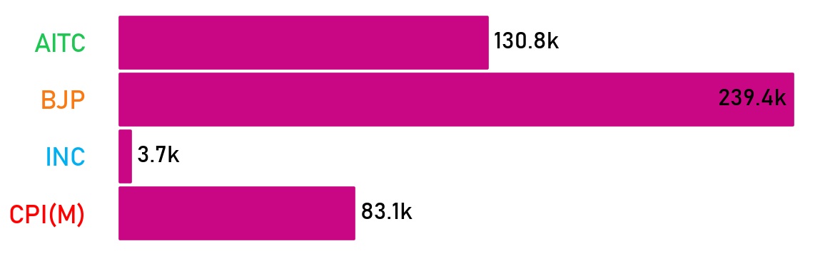
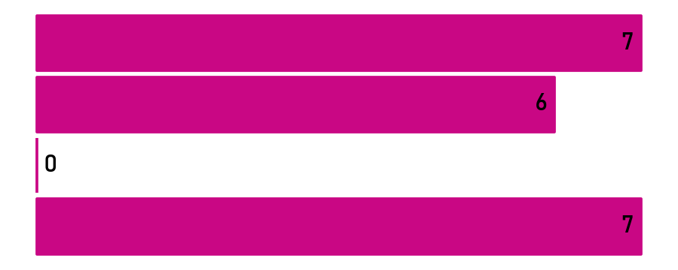
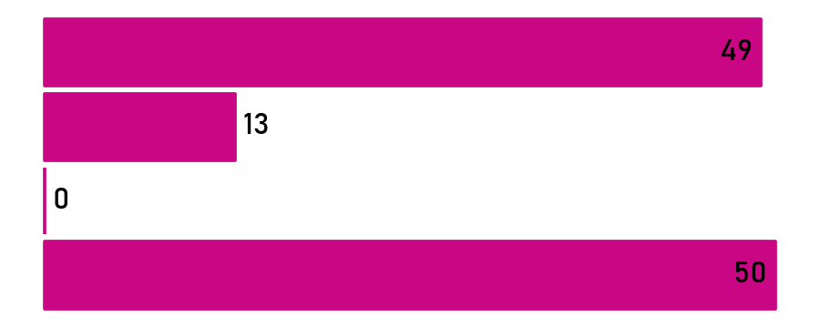
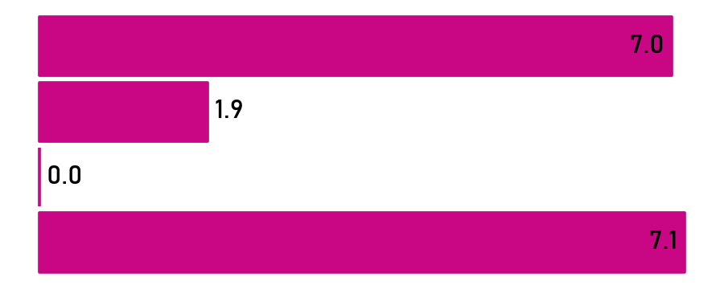
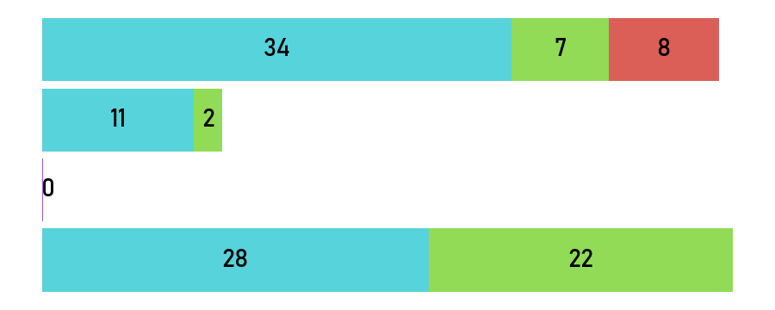
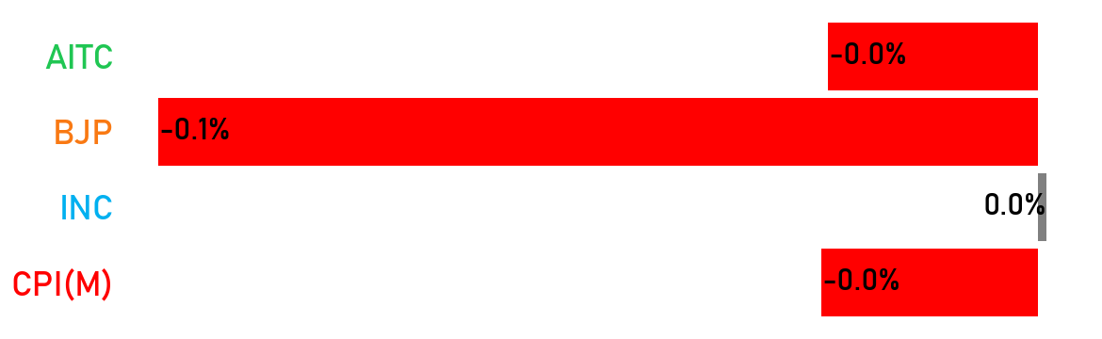
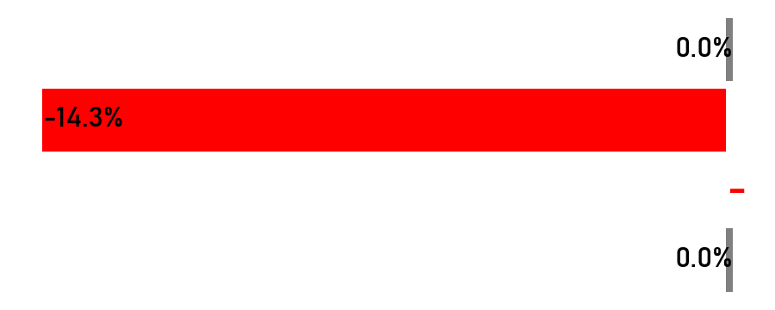
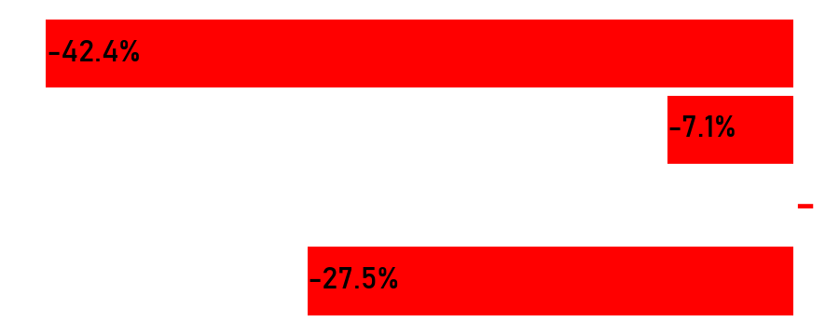
Party Official Pages Weekly Performance
Total Follower
Count of Active Days
Total Post
Avg. Post Per Days
Type of Post
Last 7 Days
Changes
*Duration: 29 Sep, 2024 – 05 Oct, 2024
Carousel Photo Reel
- No activity in previous week
- No activity in current week

Slide 24
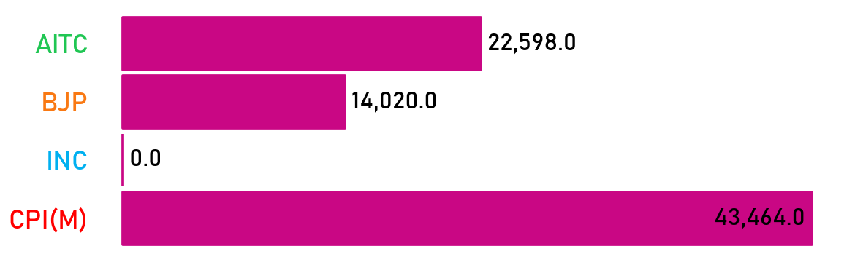
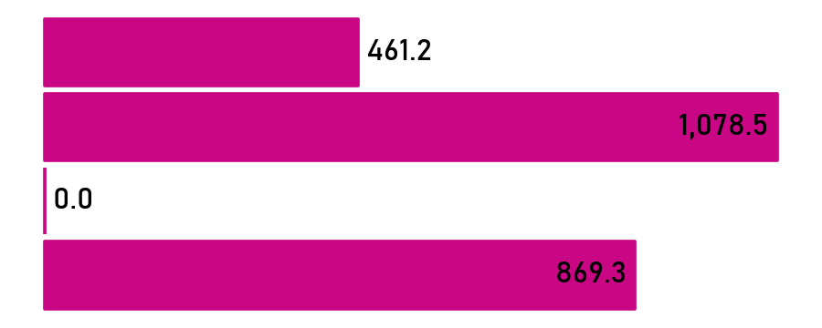
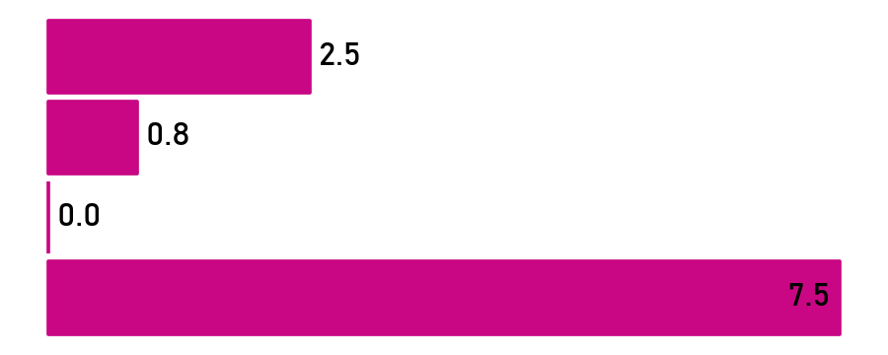
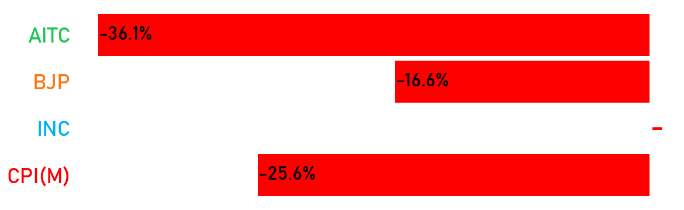
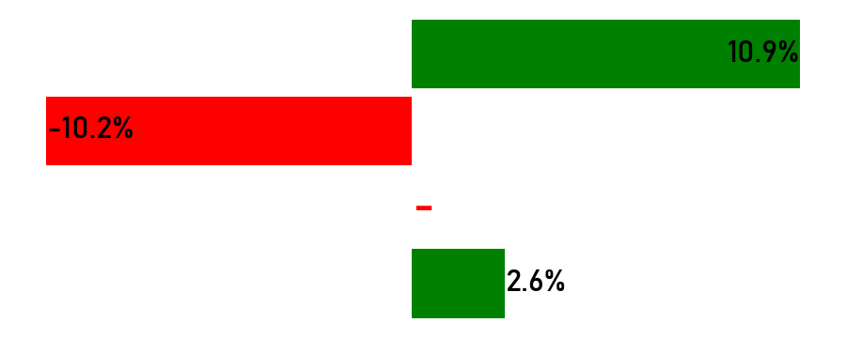
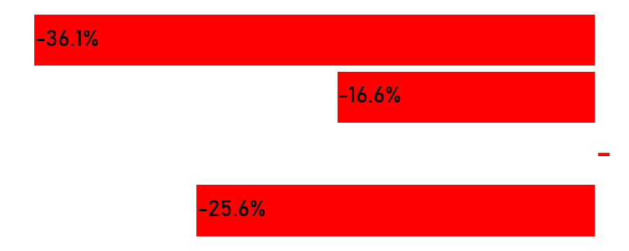
Party Official Pages Weekly Performance
Total Engagement
Avg. Engagement
Engagement Rate
Last 7 Days
Changes
*Duration: 29 Sep, 2024 – 05 Oct, 2024
- No activity in previous week
- No activity in current week

Slide 25
SMA
YouTube (All Parties)

Slide 26
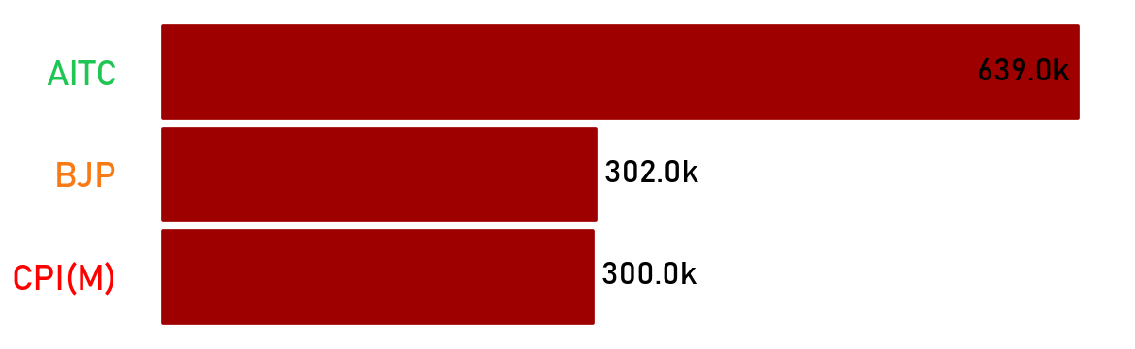
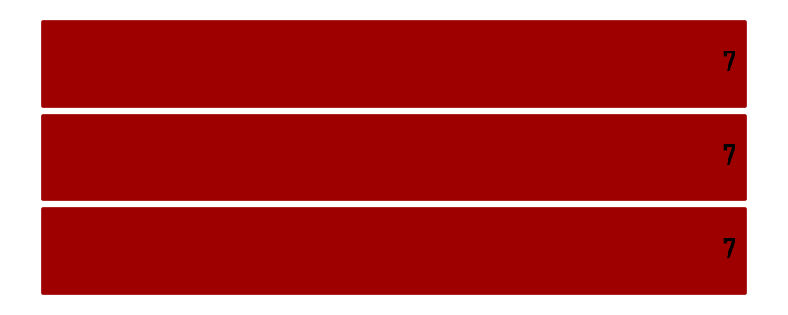
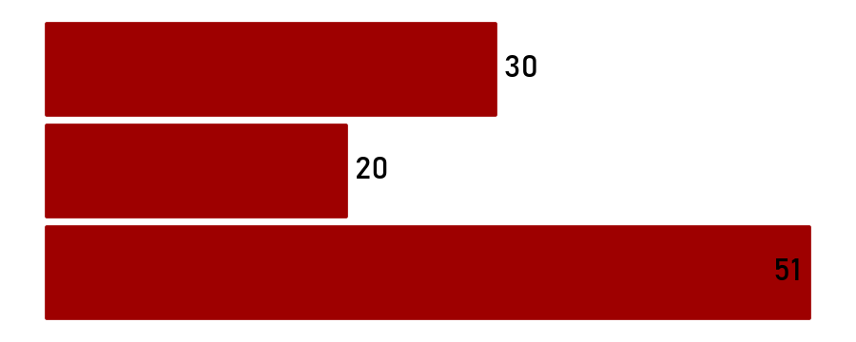
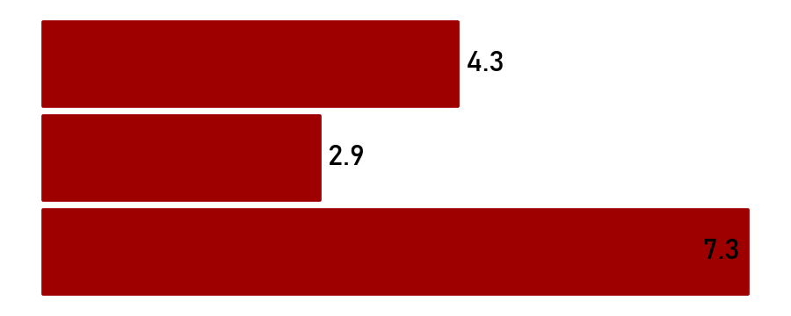



Party Official Pages Weekly Performance
Total Follower
Count of Active Days
Total Post
Avg. Post Per Days
Last 7 Days
Changes
*Duration: 29 Sep, 2024 – 05 Oct, 2024
- No activity in previous week
- No activity in current week

Slide 27










Party Official Pages Weekly Performance
Total Engagement
Avg. Engagement
Engagement Rate
Total Video Views
Avg. Video Views
Last 7 Days
Changes
*Duration: 29 Sep, 2024 – 05 Oct, 2024

Slide 28
SMA
Section 1.3:
Party Official Pages Most Engaging Post

Slide 29
SMA
Section 2:
Leaders Analysis

Slide 30




Party Official Pages Most Engaging Post
AITC
BJP
INC
CPI(M)
Video: I came to Uma's house. The world was drunk with the festival of life.
Video: The BJP has won each of the 9 seats in the election to the managing committee of the Mohammadpur Krishi Unya Samiti Ltd. in Nandigram.
Congratulations to all the winning candidates!
Photo: West Bengal Pradesh Congress President Shubhankar Sarkar met with the presidents of various district Congress committee and the leadership of branch organizations at West Bengal Pradesh Congress headquarters 'Vidhan Bhavan' today. Annual Congress leader and former MP Pradeep Bhattacharya, AICC Secretary Asif Ali Khan Chiefs were present.
Photo: Accused of rape and murder of a 10 year old school girl in Jaynagar. Again the ultimate anarchy of the police with the body. Leftist students, youth, women at the spot.
Engagement: 6,296
Reactions: 5,249
Comments: 476
Shares: 571
Engagement: 4,586
Reactions: 4,137
Comments: 88
Shares: 361
Engagement: 471
Reactions: 369
Comments: 25
Shares: 77
Engagement: 2,091
Reactions: 1,691
Comments: 66
Shares: 334
Read more in FB
Read more in FB
Read more in FB
Read more in FB

Slide 31




Party Official Pages Most Engaging Post
AITC
BJP
INC
CPI(M)
Video: On the occasion of Mahalaya, we witness the beginning of Debipokkho and welcome Maa Durga in our midst! To mark this auspicious celebration, Smt. @MamataOfficial
inaugurated several pandals across Bengal.
Video: Happy Mahalaya!
Video: Pradesh Congress President Mr. Shubhankar Sarkar informed about the celebration of Gandhi Jayanti and former Prime Minister Lal Bahadur Shastri's birth anniversary in a march in front of the West Bengal Pradesh Congress office today.
Photo: 10-year-old school girl accused of rape and murder in Jayanagar. Once again the ultimate anarchy with the body of the police. Left wing students, youth, women on the spot.
Engagement: 1,103
Likes: 800
Retweets: 268
Replies: 35
Engagement: 496
Likes: 410
Retweets: 63
Replies: 23
Engagement: 75
Likes: 54
Retweets: 20
Replies: 1
Engagement: 192
Likes: 151
Retweets: 30
Replies: 11
Read more in X
Read more in X
Read more in X
Read more in X

Slide 32



Party Official Pages Most Engaging Post
AITC
BJP
INC
CPI(M)
No Post
Reel: On the occasion of Mahalaya, we witness the beginning of Debipokkho and welcome Maa Durga in our midst! To mark this auspicious celebration, Smt. @mamataofficial inaugurated several pandals across Bengal. From Hatibagan Sarbojanin, Babubagan, Selimpur Pally, 95 Pally Association, Jodhpur Park, and Chetla Agrani Club to the virtual opening of 320 pujas in different parts of Bengal.
Photo: The beautiful thing about education is that no one can take it away from you. State BJP president Dr. Sukanta Majumder visited Eklbaya school in Buniyadpur and gave lessons to students studying there.
Photo: Unique Sitaram. Red salute to Comrade Sitaram Yechuri. #SitaramYechury
Engagement: 2,279
Likes: 2,258
Comments: 21
Engagement: 3,566
Likes: 3,496
Comments: 70
Engagement: 2,516
Likes: 2,502
Comments: 14
Read more in Insta
Read more in Insta
Read more in Insta

Slide 33



Party Official Pages Most Engaging Post
AITC
BJP
INC
CPI(M)
No Account
Title: Mamata Banerjee Inaugurates Pujo Pandals Across Kolkata
Title: "Opposition leader Mr. Suvendu Adhikari is present at the BJP's protest march from Ramanagar Lalupul Bridge."
Title: "Demand justice for Tilottama
#cpim #reels #shorts"
Engagement: 395
Likes: 391
Comments: 4
Views: 4,138
Engagement: 589
Likes: 535
Comments: 54
Views: 25,707
Engagement: 3,466
Likes: 3,444
Comments: 22
Views: 1,30,272
Read more in YouTube
Read more in YouTube
Read more in YouTube

Slide 34
SMA
Section 2.1:
Top Leaders Pages Summary

Slide 35
Top Leaders Official Pages Overview - Overall
Overall
Party | Leaders | Facebook |  |  |  | Instagram |  |  |  | Twitter |  |  |  | YouTube
 |  | Total Follower | Avg. Post Per Day | Average Engagement | Engagement Rate | Total Follower | Average Post Per Day | Average Engagement | Engagement Rate | Total Follower | Average Post Per Day | Average Engagement | Engagement Rate | Total Follower | Average Video Views | Average Engagement | Engagement Rate
AITC | Mamata Banerjee | 5.3M | 4.5 | 11,059.4 | 0.9 | 419.3k | 0.3 | 9,665.1 | 0.8 | 7.6M | 1.1 | 4,130.0 | 0.1 | 1.8k | - | - | -
 | Abhishek Banerjee | 2.2M | 1.2 | 6,250.1 | 0.3 | 109.0k | - | - | - | 684.7k | 0.3 | 3,795.8 | 0.1 | 46.3k | - | - | -
BJP | Dilip Ghosh | 885.4k | 4.7 | 2,493.9 | 1.3 | 49.8k | - | - | - | 399.2k | 4.5 | 147.9 | 0.2 | 90.8k | 882.6 | 61.8 | 0.0
 | Suvendu Adhikari | 793.3k | 4.4 | 4,073.3 | 2.2 | 57.7k | 3.5 | 1,017.9 | 6.1 | 278.8k | 2.5 | 3,499.7 | 3.1 | 189.0k | 11,545.1 | 738.0 | 1.4
INC | Adhir Ranjan Chowdhury | 400.9k | 0.9 | 490.7 | 0.1 | - | - | - | - | 81.6k | 0.3 | 150.6 | 0.0 | - | - | - | -
CPI(M) | Sujan Chakraborty | 270.2k | 1.5 | 310.4 | 0.2 | 24.7k | 2.2 | 309.3 | 2.8 | 124.3k | 1.7 | 214.9 | 0.3 | 5.2k | - | - | -
 | Md. Salim | 239.3k | 3.3 | 430.4 | 0.6 | - | - | - | - | 82.3k | 0.7 | 236.4 | 0.2 | - | - | - | -
*Duration: 29 Sep, 2024 – 05 Oct, 2024

Slide 36
Top Leaders Official Pages Overview – Last 7 Days
Last 7 Days
Party | Leaders | Facebook |  |  |  | Instagram |  |  |  | Twitter |  |  |  | YouTube
 |  | Total Follower | Avg. Post Per Day | Average Engagement | Engagement Rate | Total Follower | Average Post Per Day | Average Engagement | Engagement Rate | Total Follower | Average Post Per Day | Average Engagement | Engagement Rate | Total Follower | Average Video Views | Average Engagement | Engagement Rate
AITC | Mamata Banerjee | 5.3M | 14.3 | 10,639.1 | 2.9 | 419.3k | 0.9 | 4,400.3 | 0.9 | 7.6M | 1.6 | 3,244.2 | 0.1 | 1.8k | - | - | -
 | Abhishek Banerjee | 2.2M | 1.3 | 5,870.8 | 0.3 | 109.0k | - | - | - | 684.7k | 0.1 | 2,606.0 | 0.1 | 46.3k | - | - | -
BJP | Dilip Ghosh | 885.0k | 4.9 | 1,978.2 | 1.1 | 49.8k | - | - | - | 399.2k | 4.9 | 60.7 | 0.1 | 90.8k | 583.8 | 40.2 | 0.0
 | Suvendu Adhikari | 793.3k | 4.4 | 3,629.5 | 2.0 | 57.7k | 3.1 | 713.3 | 3.9 | 278.8k | 2.4 | 3,461.1 | 3.0 | 189.0k | 7,633.8 | 481.3 | 0.9
INC | Adhir Ranjan Chowdhury | 400.5k | 0.4 | 347.3 | 0.0 | - | - | - | - | 81.6k | 0.6 | 98.2 | 0.1 | - | - | - | -
CPI(M) | Sujan Chakraborty | 270.0k | 1.3 | 241.3 | 0.1 | 24.7k | 1.1 | 201.2 | 0.9 | 124.3k | 1.0 | 258.1 | 0.2 | 5.2k | - | - | -
 | Md. Salim | 239.2k | 2.0 | 344.0 | 0.3 | - | - | - | - | 82.3k | 0.4 | 277.0 | 0.1 | - | - | - | -
*Duration: 29 Sep, 2024 – 05 Oct, 2024

Slide 37
SMA
Section 2.2:
Top Leaders Pages Most Engaging Post

Slide 38
Top Leader Official Pages (7 DMA)
AVERAGE POST PER DAY
FOLLOWER
AVERAGE ENGAGEMENT
ENGAGEMENT RATE
*Duration: 29 Sep, 2024 – 05 Oct, 2024
— Mamata Banerjee — Abhishek Banerjee — Suvendu Adhikari — Dilip Ghosh — Adhir Ranjan Chowdhury — Md. Salim — Sujan Chakraborty

Slide 39
Top Leader Official Pages (7 DMA)
AVERAGE POST PER DAY
FOLOWER
AVERAGE ENGAGEMENT
ENGAGEMENT RATE
*Duration: 29 Sep, 2024 – 05 Oct, 2024
— Mamata Banerjee — Abhishek Banerjee — Suvendu Adhikari — Dilip Ghosh — Adhir Ranjan Chowdhury — Md. Salim — Sujan Chakraborty

Slide 40
Top Leader Official Pages (7 DMA)
AVERAGE POST PER DAY
FOLLOWER
AVERAGE ENGAGEMENT
ENGAGEMENT RATE
*Duration: 29 Sep, 2024 – 05 Oct, 2024
— Mamata Banerjee — Abhishek Banerjee — Suvendu Adhikari — Dilip Ghosh — Adhir Ranjan Chowdhury — Md. Salim — Sujan Chakraborty

Slide 41
Top Leader Official Pages (7 DMA)
AVERAGE POST PER DAY
FOLLOWER
AVERAGE ENGAGEMENT
ENGAGEMENT RATE
*Duration: 29 Sep, 2024 – 05 Oct, 2024
— Mamata Banerjee — Abhishek Banerjee — Suvendu Adhikari — Dilip Ghosh — Adhir Ranjan Chowdhury — Md. Salim — Sujan Chakraborty

Slide 42
SMA
Section 2.3:
All Leaders Weekly Comparative Analysis

Slide 43




SMA
Top leaders Most Engaging Post (Last 7 Days)
Mamata Banerjee
Suvendu Adhikari
Adhir Ranjan Chowdhury
Sujan Chakraborty
Video: Inauguration of Singhi Park Sarbojanin Durga Pujo
Live Video: Inauguration of Shree Shree Durga Puja at Santosh Mitra Square in Kolkata.
Photo: The best way to find yourself is to lose yourself in the service of others.
— Mahatma Gandhi
Photo: #AmarGhorRGKar
Engagement: 1,01,023
Reactions: 94,126
Comments: 4,222
Shares: 2,675
Engagement: 19,891
Reactions: 17,706
Comments: 1,298
Shares: 887
Engagement: 411
Reactions: 362
Comments:21
Shares: 28
Engagement: 663
Reactions: 571
Comments: 35
Shares: 57
Read more in FB
Read more in FB
Read more in FB
Read more in FB

Slide 44




Top leaders Most Engaging Post (Last 7 Days)
Mamata Banerjee
Suvendu Adhikari
Adhir Ranjan Chowdhury
Sujan Chakraborty
Engagement: 5,178
Likes: 3,416
Retweets: 1,295
Replies: 467
Engagement: 12,875
Likes: 8,617
Retweets: 3,759
Replies: 499
Engagement: 118
Likes: 104
Retweets: 9
Replies: 5
Engagement: 606
Likes: 333
Retweets: 73
Replies: 200
Read more in X
Read more in X
Read more in X
Read more in X

Slide 45



Top leaders Most Engaging Post (Last 7 Days)
Mamata Banerjee
Suvendu Adhikari
Adhir Ranjan Chowdhury
Sujan Chakraborty
No Post
Reel: Today, on Prathama, I had the pleasure of inaugurating some of Kolkata's most iconic Durga Pujos – Tala Prattoy, 25 Pally, 74 Pally, Alipore Sarbojanin, Kolahal, Behala Nutan Dal, Barisha Club, Ajeya Sanghati, 41 Pally, Bosepukur Talbagan, Sitala Mandir, Ballygunge 21 Pally, Adi Ballygunge Club, Gariahat Hindustan Club, and Kalighat Milan Sangha.
Reel: Recently, eight fishermen died after troller drowned in the middle of the sea while fishing in the Bay of Bengal. Today met the bereaved families of fishermen in Kailash Nagar, Kakdeep and talked to them. I assured that I will be with every family by handing over financial aid and some necessary items from BJP.
Reel: It is not equal to impose junior doctors, nurses, employees in charge of the government's misery.
Engagement: 7,288
Likes: 7,288
Comments: 0
Engagement: 1,969
Likes: 1,938
Comments: 31
Engagement: 265
Likes: 262
Comments: 3
Read more in Insta
Read more in Insta
Read more in Insta

Slide 46

Top leaders Most Engaging Post (Last 7 Days)
Mamata Banerjee
Suvendu Adhikari
Adhir Ranjan Chowdhury
Sujan Chakraborty
No Post
No Account
No Account
Title: "Multiple forms in the same body."
Engagement: 3,149
Likes: 3,113
Comments: 36
Views: 77,881
Read more in YouTube

Slide 47
SMA
Facebook (All Leaders)

Slide 48






Followers and Activity Weekly Performance
Total Follower
Follower Growth
Count of Active Days
Active Days Growth
Total Post
Total Post Growth
*Duration: 29 Sep, 2024 – 05 Oct, 2024
- No activity in previous week
- No activity in current week

Slide 49




Activity and Views Weekly Performance
Avg. Post Per Day
Avg. Post Per Day Growth
Type of Post
Avg. Video Views
Avg. Video Views Growth
*Duration: 29 Sep, 2024 – 05 Oct, 2024
Link Photo Status Video
- No activity in previous week
- No activity in current week

Slide 50






Engagement Weekly Performance
Total Engagement
Engagement Growth
Avg. Engagement
Avg. Engagement Growth
Engagement Rate
Engagement Rate Growth
*Duration: 29 Sep, 2024 – 05 Oct, 2024
- No activity in previous week
- No activity in current week

Slide 51
SMA
Twitter (All Leaders)

Slide 52






Followers and Activity Weekly Performance
Total Follower
Follower Growth
Count of Active Days
Active Days Growth
Total Post
Total Post Growth
*Duration: 29 Sep, 2024 – 05 Oct, 2024
- No activity in previous week
- No activity in current week

Slide 53




Activity and Views Weekly Performance
Avg. Post Per Day
Avg. Post Per Day Growth
Type of Post
Avg. Video Views
Avg. Video Views Growth
*Duration: 29 Sep, 2024 – 05 Oct, 2024
Link Photo Status Video
- No activity in previous week
- No activity in current week

Slide 54






Engagement Weekly Performance
Total Engagement
Engagement Growth
Avg. Engagement
Avg. Engagement Growth
Engagement Rate
Engagement Rate Growth
*Duration: 29 Sep, 2024 – 05 Oct, 2024
- No activity in previous week
- No activity in current week

Slide 55


Impression Weekly Performance
Avg. Impression
Avg. Impression Growth
*Duration: 29 Sep, 2024 – 05 Oct, 2024
- No activity in previous week
- No activity in current week

Slide 56
SMA
Instagram (All Leaders)

Slide 57






Followers and Activity Weekly Performance
Total Follower
Follower Growth
Count of Active Days
Active Days Growth
Total Post
Total Post Growth
*Duration: 29 Sep, 2024 – 05 Oct, 2024
- No activity in previous week
- No activity in current week

Slide 58


Activity Weekly Performance
Avg. Post Per Day
Avg. Post Per Day Growth
Type of Post
Avg. Video Views
Avg. Video Views Growth
*Duration: 29 Sep, 2024 – 05 Oct, 2024
Carousel Photo Reel
- No activity in previous week
- No activity in current week

Slide 59






Engagement Weekly Performance
Total Engagement
Engagement Growth
Avg. Engagement
Avg. Engagement Growth
Engagement Rate
Engagement Rate Growth
*Duration: 29 Sep, 2024 – 05 Oct, 2024
- No activity in previous week
- No activity in current week

Slide 60
SMA
YouTube (All Leaders)

Slide 61






Followers and Activity Weekly Performance
Total Follower
Follower Growth
Count of Active Days
Active Days Growth
Total Post
Total Post Growth
*Duration: 29 Sep, 2024 – 05 Oct, 2024
- No activity in previous week
- No activity in current week

Slide 62





Activity and Views Weekly Performance
Avg. Post Per Day
Avg. Post Per Day Growth
Total Video Views
Video Views Growth
Avg. Video Views
Avg. Video Views Growth
*Duration: 29 Sep, 2024 – 05 Oct, 2024
- No activity in previous week
- No activity in current week

Slide 63






Engagement Weekly Performance
Total Engagement
Engagement Growth
Avg. Engagement
Avg. Engagement Growth
Engagement Rate
Engagement Rate Growth
*Duration: 29 Sep, 2024 – 05 Oct, 2024
- No activity in previous week
- No activity in current week

Slide 64
SMA
Section 3:
Campaign Pages Weekly Comparative Analysis

Slide 65
SMA
Facebook (Campaign Pages )

Slide 66






Followers and Activity Weekly Performance
Total Follower
Follower Growth
Count of Active Days
Active Days Growth
Total Post
Total Post Growth
*Duration: 29 Sep, 2024 – 05 Oct, 2024
- No activity in previous week
- No activity in current week

Slide 67




Activity and Views Weekly Performance
Avg. Post Per Day
Avg. Post Per Day Growth
Type of Post
Avg. Video Views
Avg. Video Views Growth
*Duration: 29 Sep, 2024 – 05 Oct, 2024
Video Status Photo
- No activity in previous week
- No activity in current week

Slide 68





Engagement Weekly Performance
Total Engagement
Engagement Growth
Avg. Engagement
Avg. Engagement Growth
Engagement Rate
Engagement Rate Growth
*Duration: 29 Sep, 2024 – 05 Oct, 2024
- No activity in previous week
- No activity in current week

Slide 69
SMA
Twitter (Campaign Pages )

Slide 70






Followers and Activity Weekly Performance
Total Follower
Follower Growth
Count of Active Days
Active Days Growth
Total Post
Total Post Growth
*Duration: 29 Sep, 2024 – 05 Oct, 2024
- No activity in previous week
- No activity in current week

Slide 71




Activity and Views Weekly Performance
Avg. Post Per Day
Avg. Post Per Day Growth
Type of Post
Avg. Video Views
Avg. Video Views Growth
*Duration: 29 Sep, 2024 – 05 Oct, 2024
Video Status Photo
- No activity in previous week
- No activity in current week

Slide 72






Engagement Weekly Performance
Total Engagement
Engagement Growth
Avg. Engagement
Avg. Engagement Growth
Engagement Rate
Engagement Rate Growth
*Duration: 29 Sep, 2024 – 05 Oct, 2024
- No activity in previous week
- No activity in current week

Slide 73


Impression Weekly Performance
Avg. Impression
Avg. Impression Growth
*Duration: 29 Sep, 2024 – 05 Oct, 2024
- No activity in previous week
- No activity in current week

Slide 74
SMA
Instagram (Campaign Pages )

Slide 75






Followers and Activity Weekly Performance
Total Follower
Follower Growth
Count of Active Days
Active Days Growth
Total Post
Total Post Growth
*Duration: 29 Sep, 2024 – 05 Oct, 2024
- No activity in previous week
- No activity in current week

Slide 76


Activity Weekly Performance
Avg. Post Per Day
Avg. Post Per Day Growth
Type of Post
Avg. Video Views
Avg. Video Views Growth
Carousel Photo Reel
- No activity in previous week
- No activity in current week

Slide 77






Engagement Weekly Performance
Total Engagement
Engagement Growth
Avg. Engagement
Avg. Engagement Growth
Engagement Rate
Engagement Rate Growth
*Duration: 29 Sep, 2024 – 05 Oct, 2024
- No activity in previous week
- No activity in current week

Slide 78
SMA
YouTube (Campaign Pages )

Slide 79





Followers and Activity Weekly Performance
Total Follower
Follower Growth
Count of Active Days
Active Days Growth
Total Post
Total Post Growth
*Duration: 29 Sep, 2024 – 05 Oct, 2024
- No activity in previous week
- No activity in current week

Slide 80





Activity and Views Weekly Performance
Avg. Post Per Day
Avg. Post Per Day Growth
Total Video Views
Video Views Growth
Avg. Video Views
Avg. Video Views Growth
- No activity in previous week
- No activity in current week

Slide 81





Engagement Weekly Performance
Total Engagement
Engagement Growth
Avg. Engagement
Avg. Engagement Growth
Engagement Rate
Engagement Rate Growth
*Duration: 29 Sep, 2024 – 05 Oct, 2024
- No activity in previous week
- No activity in current week

Slide 82
SMA
Section 4:
Annexure

Slide 83
Party Details
Parties | Facebook Link | Twitter Link | Instagram Link | YouTube Link
AITC | AITC_FB | AITC_TW | AITC_IN | AITC_YT
BJP | BJP Bengal_FB | BJP Bengal_TW | BJP Bengal_IN | BJP Bengal_YT
INC | INC Bengal_FB | INC Bengal_TW | INC Bengal_IN
CPI(M) | CPI(M) Bengal_FB | CPIM Bengal_TW | CPIM Bengal_IN | CPIM Bengal_YT

Slide 84
Leader Details
Leader | Party | Facebook Link | Twitter Link | Instagram Link | YouTube Link
Dilip Ghosh | BJP | DilipGhosh_FB | DilipGhosh_TW | DilipGhosh_IN | DilipGhosh_YT
Sukanta Majumdar | BJP | SukantaMajumdar_FB | SukantaMajumdar_TW | SukantaMajumdar_IN
Suvendu Adhikari | BJP | SuvenduAdhikari_FB | SuvenduAdhikari_TW | SuvenduAdhikari_IN | SuvenduAdhikari_YT
Amit Malviya | BJP | AmitMalviya_FB | AmitMalviya_TW | AmitMalviya_IN
John Barla | BJP | JohnBarla_FB | JohnBarla_TW | JohnBarla_IN
Agnimitra Paul | BJP | AgnimitraPaul_FB | AgnimitraPaul_TW | AgnimitraPaul_IN
Mamata Banerjee | AITC | MamataBanerjee_FB | MamataBanerjee_TW | MamataBanerjee_IN | MamataBanerjee_YT
Abhishek Banerjee | AITC | AbhishekBanerjee_FB | AbhishekBanerjee_TW | AbhishekBanerjee_IN | AbhishekBanerjee_YT
Shashi Panja | AITC | ShashiPanja_FB | ShashiPanja_TW | ShashiPanja_IN
Kakoli Ghosh Dastidar | AITC | KakoliGhosh_FB | KakoliGhosh_TW
Chandrima Bhattachariya | AITC | Chandrima_FB | Chandrima_FB
Bratya Basu | AITC | BratyaBasu_FB | BratyaBasu_TW
Kunal Ghosh | AITC | KunalGhosh_FB | KunalGhoshTW |  | KunalGhosh_YT
Debangshu Bhattacharya Dev | AITC | Debangshu_FB | Debangshu_TW | Debangshu_IN | Debangshu_IN
Derek O'Brien | AITC | DerekO'Brien_FB | DerekObrien_TW | DerekObrien_IN | DerekObrien_YT
Mahua Moitra | AITC | MahuaMoitra_FB | MahuaMoitra_TW | MahuaMoitra_IN
Saket Gokhale | AITC | SaketGokhale_FB | SaketGokhale_TW | SaketGokhale_IN
Sushmita Dev | AITC | SushmitaDev_FB | SushmitaDev_TW | SushmitaDev_IN
Dr. Santanu Sen | AITC | SantanuSen_FB | SantanuSen_TW
Mimi Chakraborty | AITC | MimiChakraborty_FB | MimiChakraborty_TW | MimiChakraborty_IN
Nussrat Jahan | AITC | NussratJahan_FB | NussratJahan_TW | NussratJahan_IN
Dr. Sujan Chakraborty | CPI(M) | SujanChakroborty_FB | Sujan_TW | Sujan_IN | Sujan_YT
Md Salim | CPI(M) | MdSalim_FB | MdSalim_TW
Surjya Kanta Mishra | CPI(M) | SuryaKanta_FB | SurjyaKanta_TW | SurjyaKanta_IN
Adhir Ranjan Chowdhury | INC | AdhirRanjan_FB | AdhirRanjan_TW

Slide 85
Campaign Details
Campaign | Party | Facebook Link | Twitter Link | Instagram Link | YouTube Link
Trinamoole Nabo Jowar | AITC | TrinamooleNaboJowar_FB | TMCNaboJowar_TW | Trinamoolenabojowar_IN | TrinamooleNaboJowar_YT
Banglar Gorbo Mamata | AITC | BanglarGorboMamata_FB | BanglarGorboMB_TW | BanglarGorboMamata_IN | BanglarGorboMamata_YT
Nirmamata | BJP | Nirmamata_FB |  |  | Nirmamata_YT
আর নয় অন্যায় 2.0 | BJP | AarNoyAnnayy_FB
Red Volunteers | BJP | RedVolunteers_FB | RedVolunteers_TW | RedVolunteers_IN

